Slide 1
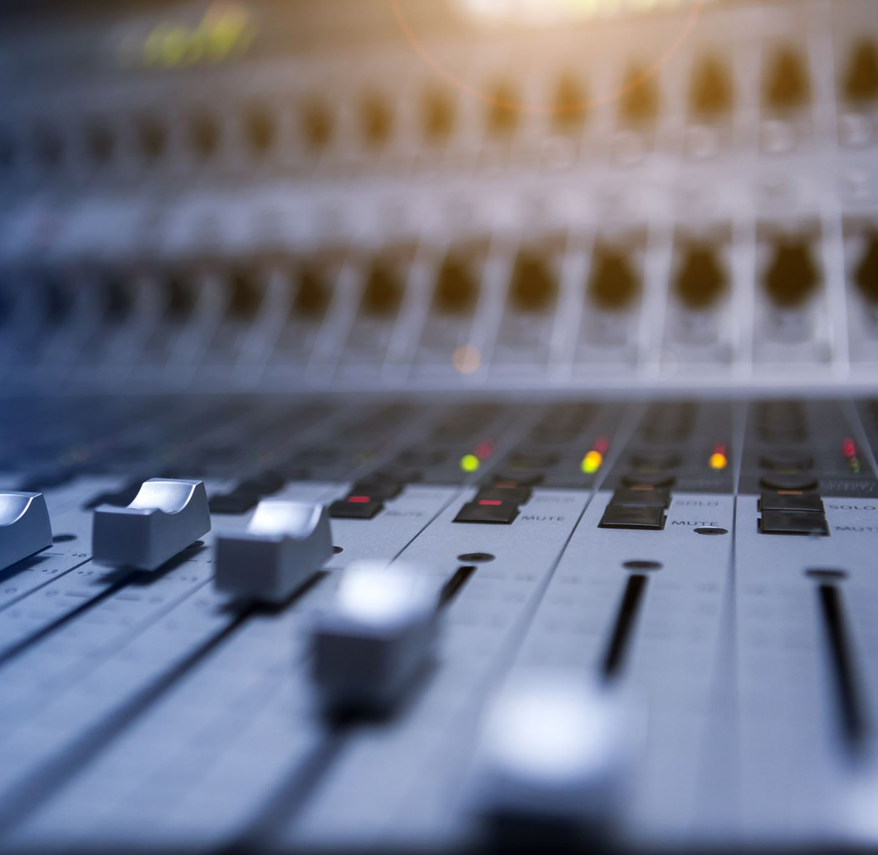
Audio Programming 2
Peter Dowsett
peter.dowsett@uwl.ac.uk

Slide 2
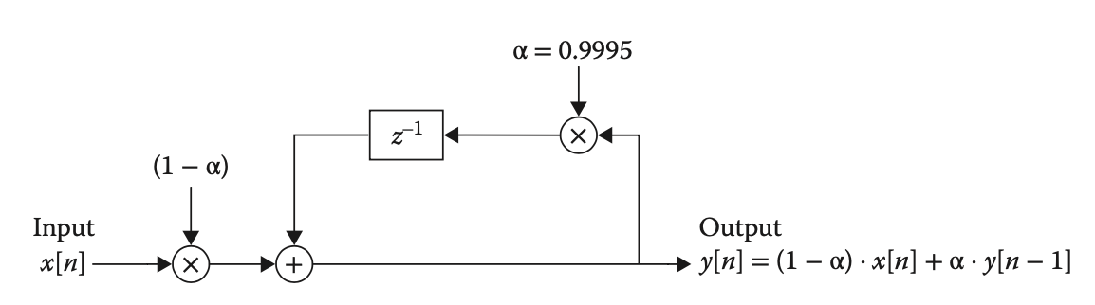
Parameter Smoothing
Before we move on let’s discuss how you can improve the gain plug-in from last week further. When the slider is moved quickly notice the discontinuities (crackles, clicks etc). To eradicate this you can add a “smoothing filter” so that the value slowly changes to its new value and therefore removes any potential discontinuities appearing in the waveform. This is done using a first-order low-pass filter.

Slide 3
Audio Programming 2
Distortion Plug-In Example

Slide 4
What is Distortion?
Distortion is the alteration of the original shape (or other characteristic) of something.
In communications and electronics it means the alteration of the waveform of an information-bearing signal, such as an audio signal representing sound or a video signal representing images, in an electronic device or communication channel.
Distortion is usually unwanted, and so engineers strive to eliminate or minimize it. In some situations, however, distortion may be desirable. ADC talk on distortion: https://www.youtube.com/watch?v=oIChUOV_0w4

Slide 5
Types of Distortion Algorithms
Bitcrusher – reducing the bit-depth of a complex audio file for creative effects
Waveshaper – passing digital audio through a non-linear function.
Analogue Modelled – using machine learning or circuit modelling to exhibit the saturation/distortion effects of analogue hardware devices such as compressors, guitar distortion pedals, tape machines and more

Slide 6
Waveshapers
A waveshaper is a very common way to implement distortion effects. They work by changing an audio signal by mapping an input signal to the output signal by applying a fixed or variable mathematical function, called the shaping function or transfer function.
Note: The function can be any function at all.
Examples of waveshaping functions:
https://www.geogebra.org/calculator/hvjrbhhh

Slide 7
Pros and Cons of Waveshaping
Pros | Cons
Simple to implement | Prone to Aliasing
Stateless (needs no memory of previous ins/outs) | Unable to capture accurate representations of complex distortions (eg tape hysteresis)
Not affected by variable and varying buffer length | People often say that they don’t sound as “three-dimensional” as analogue style distortion

Slide 8
Exercise
Create a waveshaper-based distortion plug-in. - The waveshaping must be done using a custom distortion class created from scratch. - The class must be able to handle sample-by-sample based and block-based programming and be able to switch between numerous waveshaping functions. - You must use Juce Audio Parameters and the Generic Audio Editor (e.g. an automatically generated GUI). Use the Juce API and tutorials for more information on these topics.
Feel free to extend the functionality of the plug-in with other controllable parameters such as alpha values, mix blends etc.

